Slide 1

Data Structure and Algorithms
Lecturer: Rafia Shaikh
Email: rafia.shaikh61@gmail.com
LinkedIn: https://www.linkedin.com/in/rafia-shaikh-2bab5a19a/
YouTube: https://www.youtube.com/channel/UC4GrwM0luunozFDDAYhhIIg

Slide 2
Sorting Algorithms

Slide 3
Contents
Selection Sort
Bubble Sort
Insertion Sort

Slide 4
Selection Sort
It is a simple sorting algorithm.
Selection sort is a sorting algorithm that selects the smallest element from an unsorted list in each iteration and places that element at the beginning of the unsorted list.

Slide 5
Working of Selection Sort
Select the minimum element from an array.
1
Swap the selected minimum number with the left-most element of the unsorted array.
2
Repeat step 1 and 2 until the array element are sorted.
3
Notes:
NOTE: After every pass, the minimum number set at smallest index

Slide 6
Example
10 | 2 | 8 | 6 | 7 | 3
Sort the given array using the selection sort

Slide 7
Let’s Visualize it

Slide 8
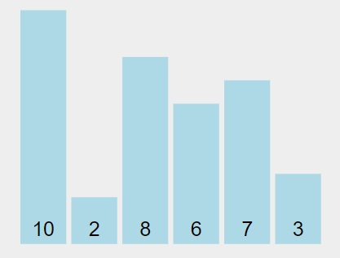

Slide 9
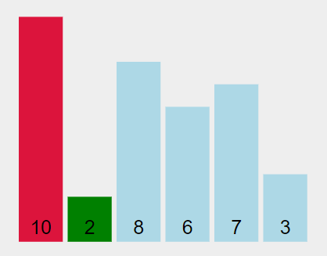

Slide 10
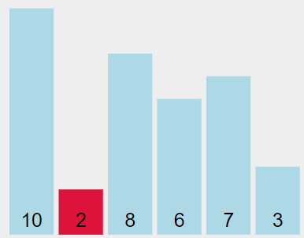

Slide 11
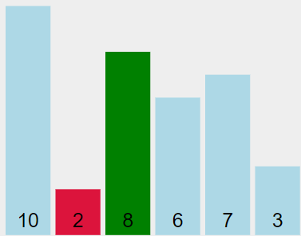

Slide 12
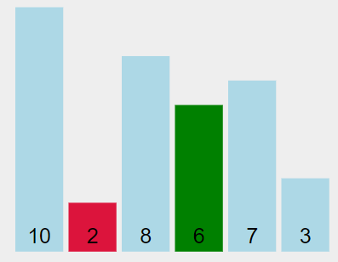

Slide 13
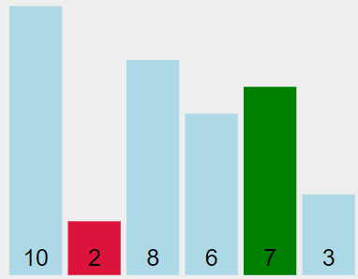

Slide 14
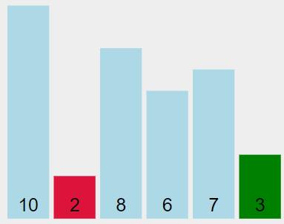

Slide 15
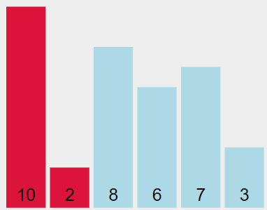

Slide 16
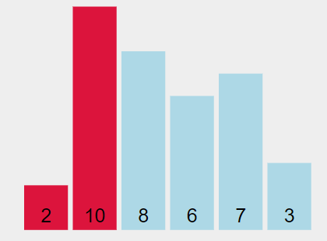

Slide 17
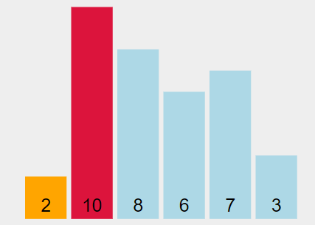

Slide 18
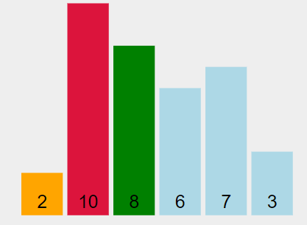

Slide 19
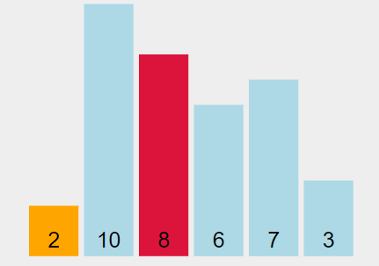

Slide 20
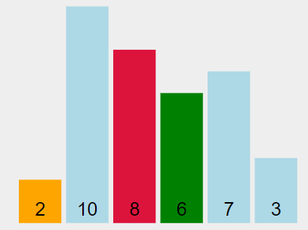

Slide 21
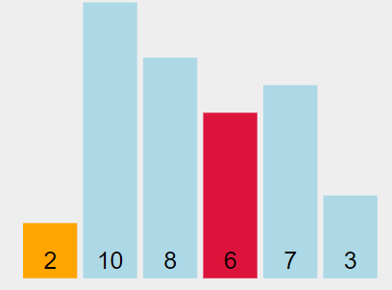

Slide 22
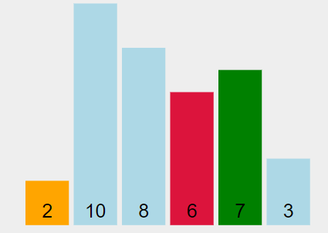

Slide 23
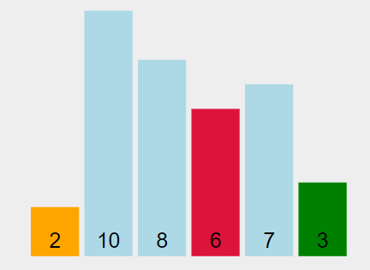

Slide 24
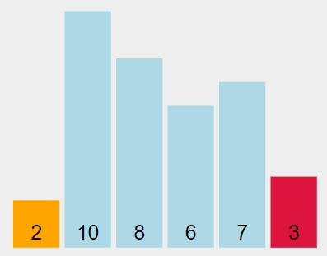

Slide 25
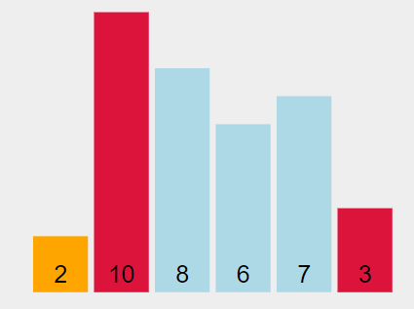

Slide 26
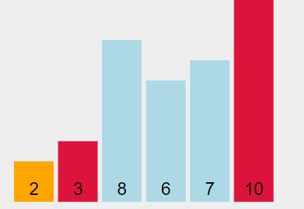

Slide 27
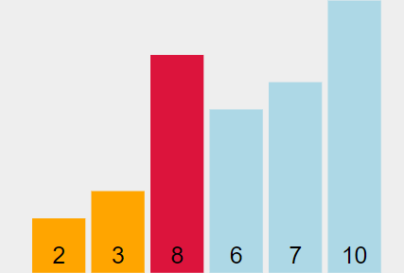

Slide 28
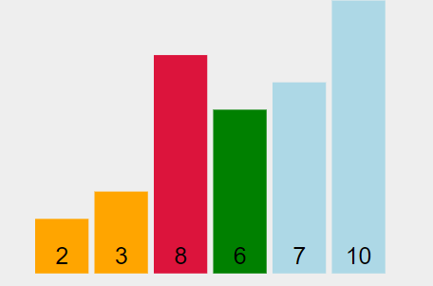

Slide 29
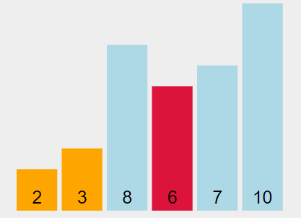

Slide 30
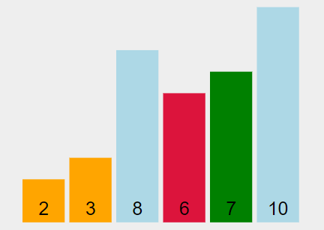

Slide 31
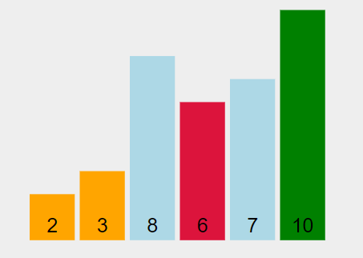

Slide 32
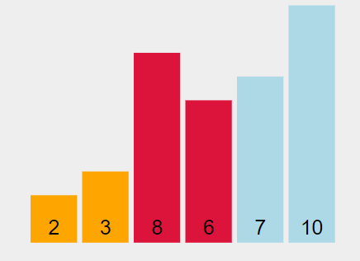

Slide 33
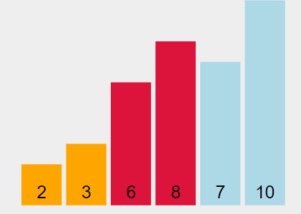

Slide 34
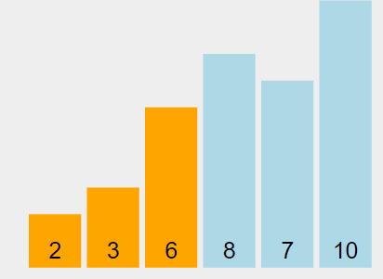

Slide 35
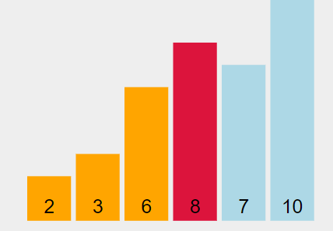

Slide 36
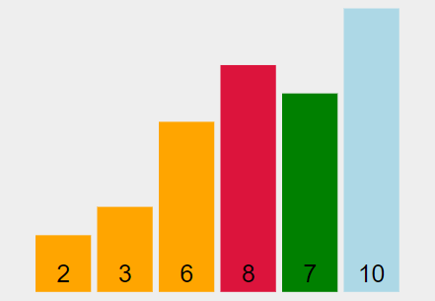

Slide 37
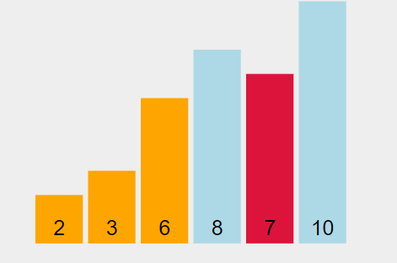

Slide 38
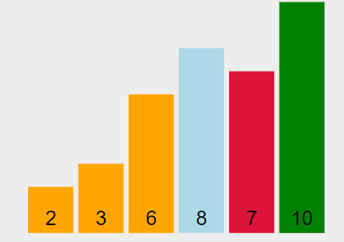

Slide 39
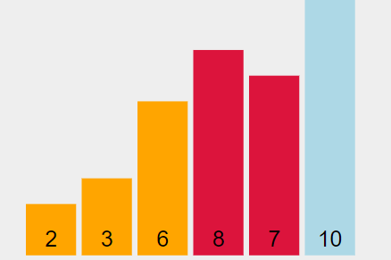

Slide 40
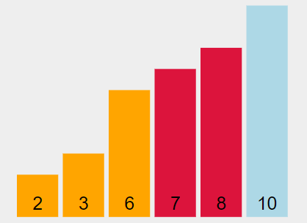

Slide 41
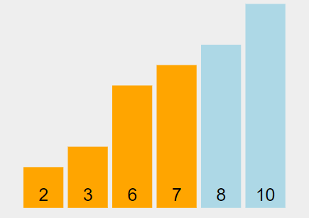

Slide 42
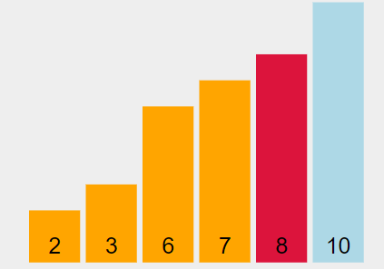

Slide 43
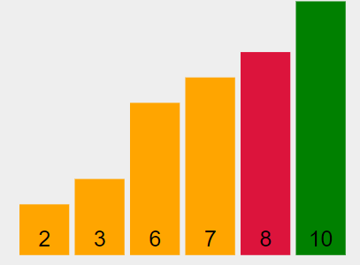

Slide 44
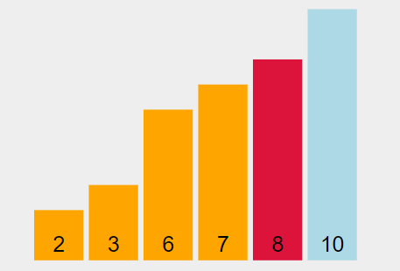

Slide 45
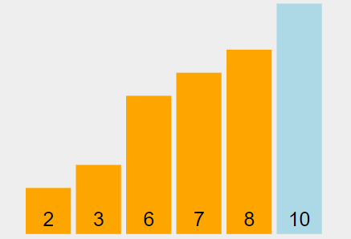

Slide 46
Pseudo-Code
for i=0 to A.length-2
mindIndex=1
temp=A[i]
A[i]=A[minIndex]
A[minIndex]=temp
for j=i+1 to A.length-2
if(A[j]<A[minIndex])
minIndex=j

Slide 47
Bubble Sort
In bubble sort, each pair of adjacent elements are compared and the elements are swapped if they are not following the ordering rule.
With each pass the largest element will bubble up at the highest index of the array.

Slide 48
Example
10 | 2 | 8 | 6 | 7 | 3
Sort the given array using the bubble sort

Slide 49

Let’s Visualize it

Slide 50
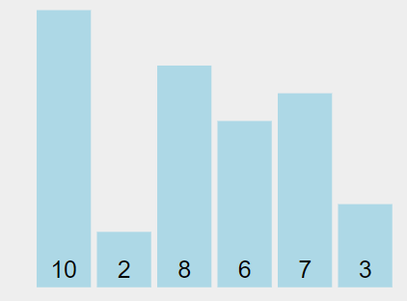

Slide 51
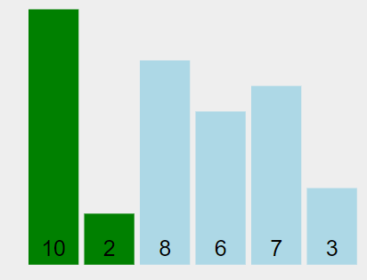

Slide 52
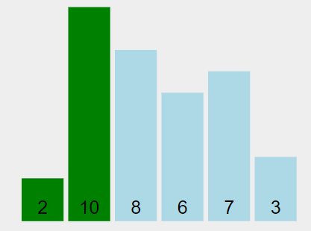

Slide 53
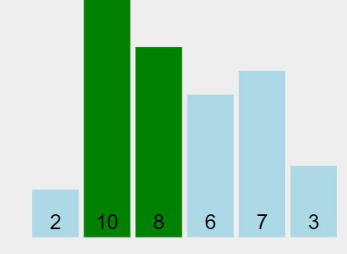

Slide 54
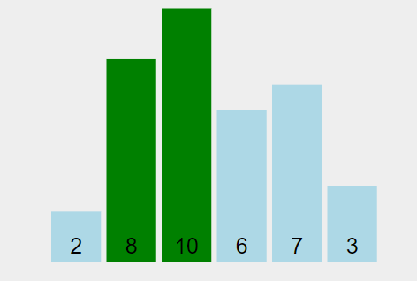

Slide 55
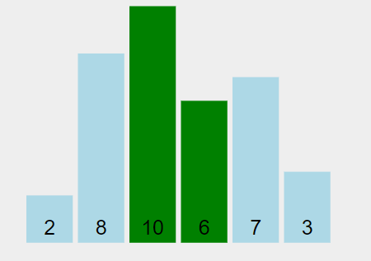

Slide 56
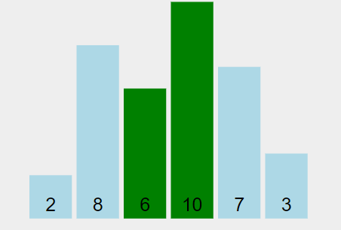

Slide 57
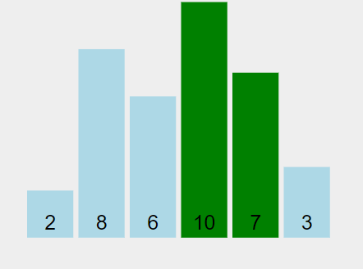

Slide 58
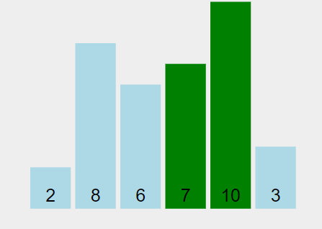

Slide 59
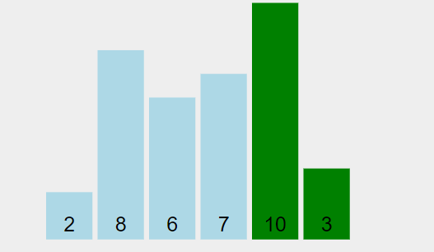

Slide 60
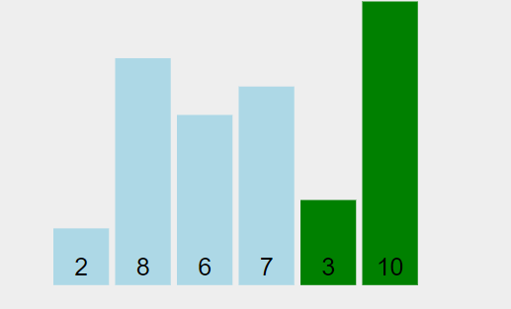

Slide 61
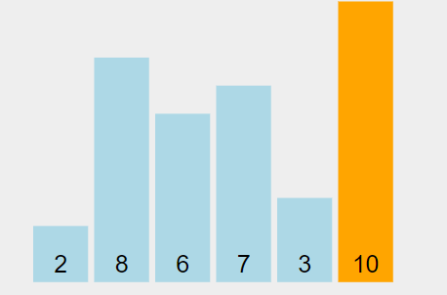

Slide 62


Slide 63


Slide 64


Slide 65
Pseudo-Code
for i=0 to A.length-2
for j=0 to A.length-2-i
if(A[j]>A[j+1])
temp=A[j+1]
A[j+1]=A[j]
A[j]=temp

Slide 66

Insertion Sort
Insertion sort is a sorting algorithm that places an unsorted element at its suitable place in each iteration.
Insertion sort works similarly as we sort cards in our hand in a card game.

Slide 67
Insertion Sort
Insertion sort is a sorting algorithm that places an unsorted element at its suitable place in each iteration.
Insertion sort works similarly as we sort cards in our hands in a card game.
Every time you get an item, insert it into a correct position in sorted order.

Slide 68
Example
10 | 2 | 8 | 6 | 7 | 3
Sort the given array using the insertion sort

Slide 69
Pseudo-Code
INSERTION-SORT(A)
for i = 1 to n
current ← A [i]
j ← i – 1
while j > = 0 and A[j] > current
A[j+1] ← A[j]
j ← j – 1
End while
A[j+1] ← current
End for

Slide 70

Task
Given Details
Total students = 5
Student heights = {180cm,165cm,150cm,170cm,145cm}
Goal
Make the row sorted.
Like below,
145cm, 150cm, 165cm, 170cm, 180cm
Use all three discussed sorting algo.

Slide 71
Thank you
Happy Coding ☺

Slide 72
References

